Slide 1




Title: Introduction to Business Analysis and AI
Subtitle: Understanding the Intersection of Business Analysis & AI
Lecturer Name: Diptarko Sharma
Date: [07-Apr-25]

Slide 2




Agenda
Introduction to Business Analysis
Introduction to AI
AI in Business
Exercises

Slide 3

A Story
Background: Anuj, a BBA graduate from a top-tier Bangalore college, pursued his passion for food by starting a restaurant in Patna. His vision was to provide a seamless dining experience with high-quality, hygienic, and affordable food for middle-class families.
Challenges:
After two years, the business was only breaking even, failing to meet his ambitious growth objectives.
Lack of differentiation and scalability in a competitive market.
Limited customer reach beyond occasional diners.
Seeking Solutions: Anuj consults his friend Narayan, a Business Analyst with expertise in problem-solving and strategy. Together, they explore ways to optimize operations, enhance customer engagement, and expand the business towards a sustainable and scalable model.

Slide 4




Understanding Business Analysis
Understanding business goals
Using analysis to uncover insights
Recommending solutions that help the business achieve its objectives.
It ensures that decision-making is grounded in data and aligned with the strategic direction of the business.

Slide 5




The Story
Background: Narayan emphasizes the importance of data in identifying problems and solutions.
Data Requirements: Customer, Sales, Employee, Product, Financial, Geographical, Competitor, Supply Chain, and Social Media Data.
Challenges in Data Availability: Anuj realizes he only has Transaction, Product, and Financial Data. Supply Chain data exists but is unstructured, and social media presence is minimal with limited customer feedback.
Next Steps: Narayan, undeterred, requests the available data in any format and prepares to conduct an initial analysis, with the possibility of requesting additional data for deeper insights.

Slide 6
Role of a Business Analyst
Key Responsibilities:
a professional who helps organizations understand their business needs, identify problems
find solutions to improve processes, products, services, and software through data analysis.
Who plays a role in aligning the designed and delivered solutions with the needs of stakeholders
Outcome:
A Business Analyst ensures successful project delivery and value realization.
They bridge the gap between IT and the business to help enhance efficiency
is a key player in organizations, acting as a bridge between business objectives and technological solutions.

Slide 7






BABOK Guide®
BABOK Guide®, which is considered industry standard for Business Analysis, developed by International Institute of Business Analysis (IIBA) says there are six knowledge areas where Business Analysts must focus on:
Business Analysis Planning and Monitoring
Elicitation and Collaboration
Requirements Life Cycle Management
Strategy Analysis
Requirements Analysis and Design Definition (RADD)
Solution Evaluation

Slide 8
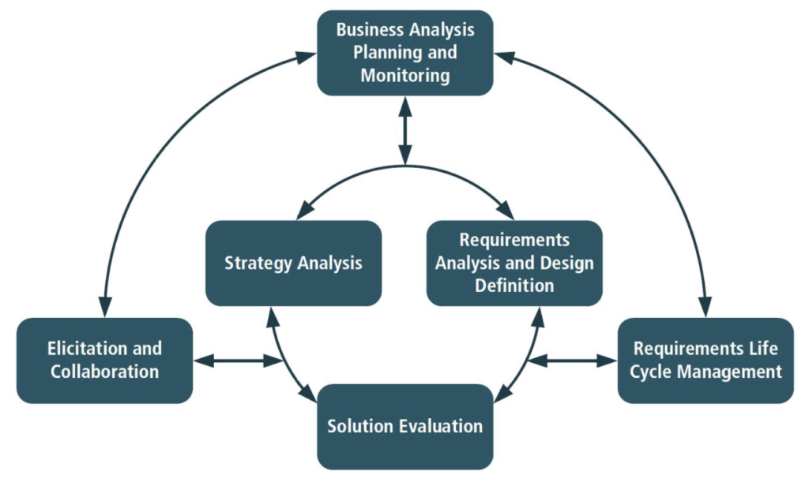
BABOK Guide®

Slide 9



The Story (Contd…)
Background:
Narayan, a Business Analyst, begins analyzing the data shared by Anuj to identify key business challenges and growth opportunities.
Challenges in Data Analysis:
Next Steps:
Narayan recognizes the need for data cleaning, structuring, and possible data collection strategies to fill gaps. He plans to extract insights from available data while recommending ways to gather missing information for deeper analysis.
Many critical datasets like Customer, Employee, Geographical, and Competitor Data are missing.
Supply Chain data is unstructured, existing only as paper bills.
The available data is not in a standard format, making it difficult to derive immediate insights.

Slide 10




Core Competencies of a Business Analyst
Technical Skills: Business modelling, data analysis, and tools (Microsoft Excel, SQL, BI tools).
Analytical Thinking: Problem-solving with data insights.
Communication Skills: Clear, concise, and effective communication.
Stakeholder Management: Managing diverse expectations and priorities.
Domain Knowledge: understanding of Business Operations, Processes and Strategies

Slide 11






Key Responsibilities
Requirements Gathering
to understand their needs and document these requirements clearly.
Data Analysis
to uncover trends, patterns, and insights that can help make informed business decisions.
Process Improvement
to increase efficiency and effectiveness.
Solution Design
which could include new software applications, process changes, or other innovations, to meet business requirements.
Testing and Validation
proposed solutions are thoroughly tested and validated to meet the business needs effectively.
Communication and Collaboration
Work closely with different teams (IT, management, other stakeholders) to ensure alignment and smooth implementation of solutions.

Slide 12



Impact on Business
Efficiency
Informed Decisions
Cost Reduction
Stakeholder Satisfaction
Optimizing processes and systems.
Providing valuable insights from data analysis.
Identifying and eliminating inefficiencies.
Ensuring that business solutions meet the needs of all stakeholders.

Slide 13
Business Analysis Process Overview
Initiation
Requirements Gathering
Analysis
Solution Design
Implementation
Evaluation
Closure
Tools and Techniques
Identify Problem
Elicitation
Current State Analysis
Develop Solution
Develop
Monitoring
Documentation
SWOT Analysis
Define Objectives
Documentation
Gap Analysis
Evaluation
Testing
Feedback
Transition
Process Mapping
Stakeholder Analysis
Validation
Deployment
Continuous Improvement
Project Closure
Use case Diagrams
Data Modelling

Slide 14
Introduction to AI
Machines that
mimic human intelligence to perform tasks like
Decision making
Speech recognition
Problem-solving

Slide 15
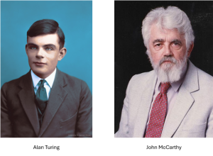
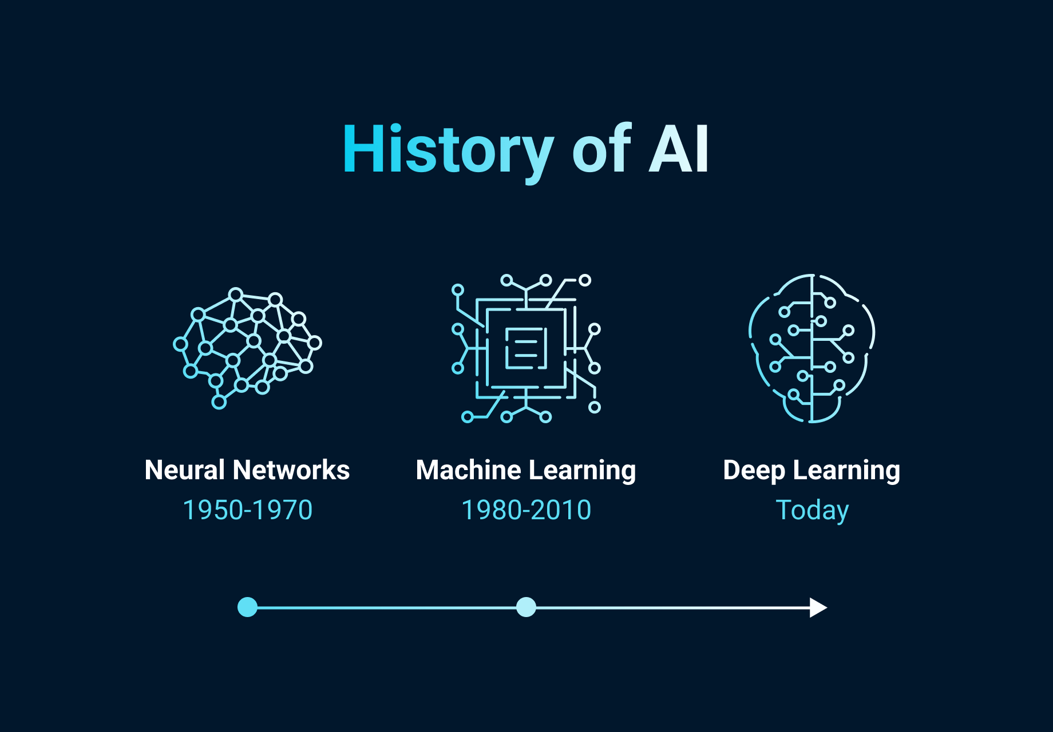
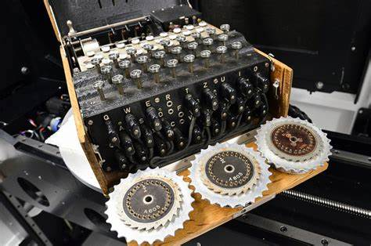
Founding Fathers of AI
John McCarthy – Father of AI
Coined the term "Artificial Intelligence"
Key contributor to AI development
Alan Turing – Theoretical Foundation of AI
Featured in The Imitation Game movie
Played a crucial role in breaking the ENIGMA code
Shortened WWII by 2 years, saving millions of lives
Introduced the Turing Test – a benchmark for AI intelligence
Developed the Turing Machine, the basis of modern computing

Slide 16
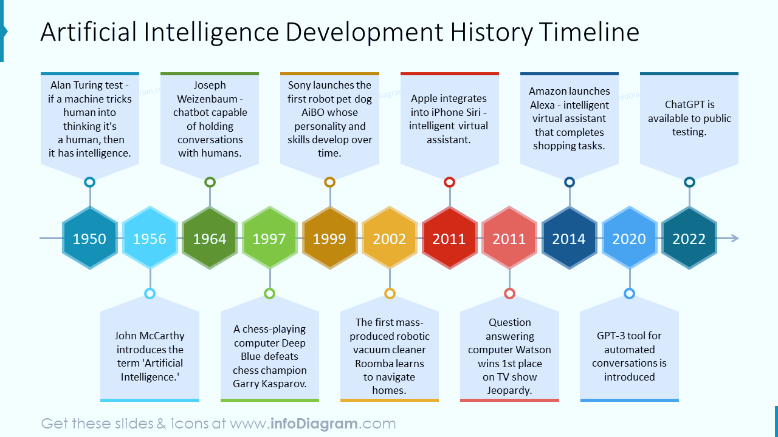

Slide 17
AI in
Healthcare
Diagnostics
Personalized Medicine
Robotic Surgery
Finance
Fraud Detection
Algorithmic Trading
Risk Management
Transportation
Traffic Management
Route Planning
Autonomous Vehicle
Retail
Personalized Recommendations
Inventory management
Customer Service
Entertainment
Content Creation
Personalized Streaming
Video games
Education
Automated Grading
Virtual Tutors
Personalized Learning
Manufacturing
Predictive Maintenance
Quality Control
Safety
Agriculture
Crop Monitoring
Pest Control
Environmental Sustainability
Renewable Energy
Wildlife Conservation

Slide 18
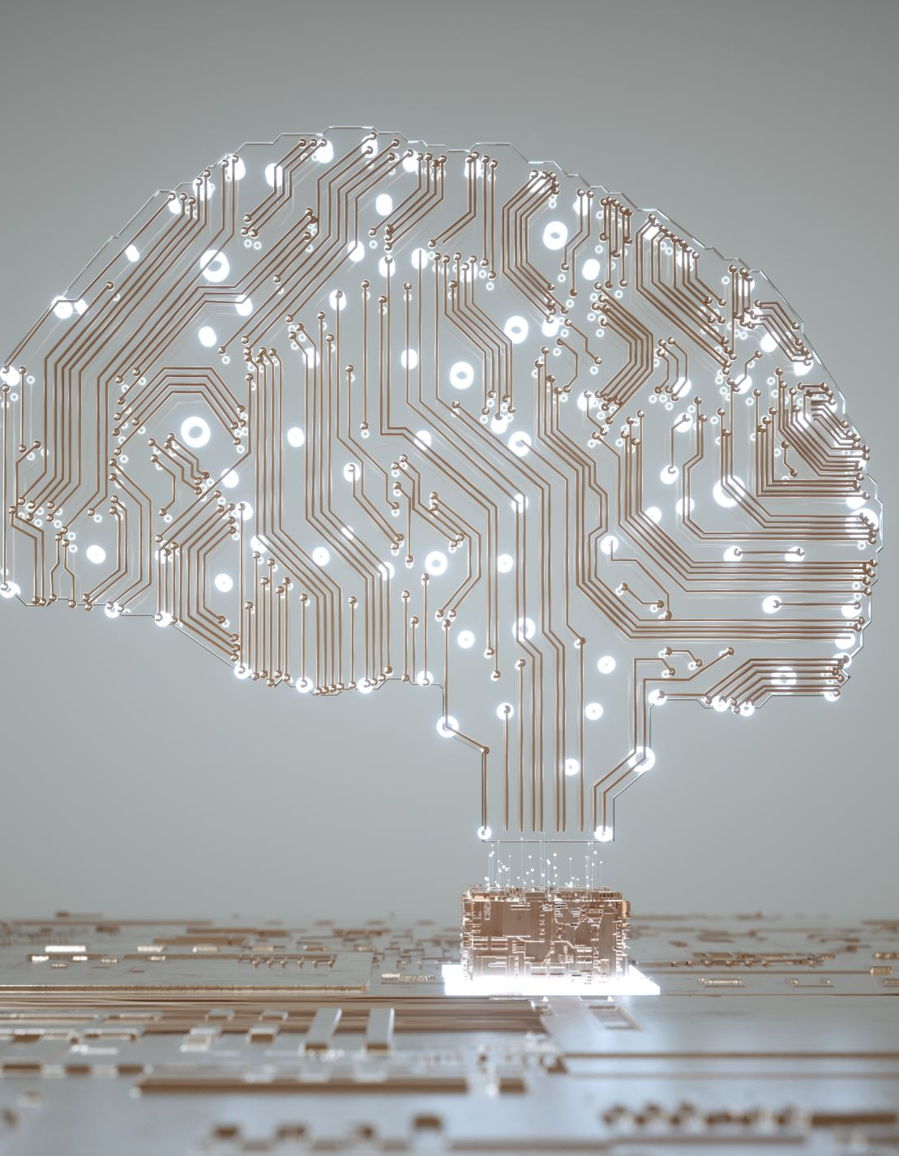
Core Areas of AI
Machine Learning
Deep Learning
Neural Networks
Natural Language Processing
Computer Vision
Reinforcement Learning

Slide 19

Basic Concepts of AI
Artificial Intelligence
Key Concepts:
Algorithms: Instructions for performing tasks.
Data: The raw input required to make decisions.
Computing Power: The infrastructure needed to process data.
Machines mimicking cognitive functions like learning, reasoning, and problem-solving.

Slide 20
How AI Works: 5-Step Process
INPUT
PROCESSING
OUTCOMES
ADJUSTMENTS
ASSESSMENTS
Data Collection: AI collects data from various sources and sorts it into categories.
Data Decoding: AI analyzes the data using patterns it’s been programmed to recognize, identifying similarities.
Prediction: Based on recognized patterns, AI predicts potential outcomes.
Learning from Mistakes: AI adjusts if outcomes fail, learning from errors and applying changes.
Continuous Improvement: AI continues to refine its predictions and processes by constantly learning from new data.

Slide 21

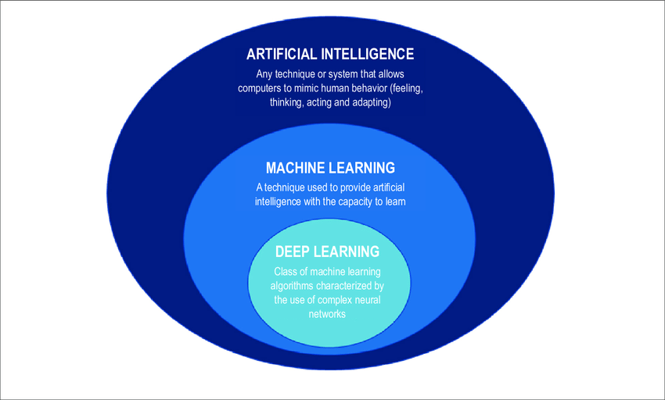
What is Artificial Intelligence? | Artificial Intelligence In 5 Minutes | AI Explained | Simplilearn

Slide 22


Machine Learning (ML)
Types of ML:
ML is a subset of AI that allows systems to learn and improve from experience without being explicitly programmed.
Supervised Learning: Training models using labeled data.
Unsupervised Learning: Finding hidden patterns in data.
Reinforcement Learning: Learning through trial and error, rewarding correct actions.

Slide 23
Machine Learning: Key Concepts
DATA
The foundation of ML, crucial for learning.
ALGORITHMS
Methods for analysing data (e.g., Decision Trees, Neural Networks).
TRAINING
Process of learning from data to generalize patterns.
FEATURES
Key attributes influencing model predictions.
LABELS
Known outcomes in supervised learning.
SUPERVISED LEARNING
Learning from labelled data (e.g., Classification, Regression).
UNSUPERVISED LEARNING
Finding patterns in unlabelled data (e.g., Clustering, Dimensionality Reduction).
MODEL EVALUATION
Measuring performance using accuracy, precision, recall, etc.
OVERFITTING & UNDERFITTING
Balancing model complexity.
HYPERPARAMETERS
Tuneable settings controlling model training.

Slide 24


Deep Learning
DL is a subset of ML that uses neural networks with many layers to process large datasets.
Key Uses:
Image Recognition
Speech Recognition
Autonomous Vehicles

Slide 25
Deep Learning: Key Concepts
LAYERS
Input Layer: Receives raw data.
Hidden Layers: Extracts patterns and features.
Output Layer: Produces predictions.
NEURAL NETWORKS
The core of deep learning, consisting of multiple layers of neurons.
ACTIVATION FUNCTIONS
Introduce non-linearity (ReLU, Sigmoid, Tanh).
TRAINING
Adjusts weights using gradient descent to minimize error.
LOSS FUNCTION
Measures error between predictions and actual values.
BACKPROPAGATION
Adjusts weights by propagating errors backward.
HYPERPARAMETERS
Controls learning (learning rate, batch size, layers).
REGULARIZATION
Prevents overfitting (Dropout, L2 Regularization).
CNNs (Convolutional Neural Networks)
Specialized for image processing.
RNNs (Recurrent Neural Networks)
Designed for sequential data (e.g., time series, NLP).

Slide 26

AI in Business Overview
AI Impact: AI has revolutionized industries by optimizing processes, improving decision-making, and creating personalized experiences.

Slide 27
AI in Business: Key Applications
AUTOMATION
Automates repetitive tasks (e.g., chatbots, data entry).
DATA ANALYSIS
Processes vast data for insights and predictions.
CUSTOMER SERVICE
AI chatbots provide 24/7 support.
PERSONALIZATION
Tailors marketing, products, and services.
SUPPLY CHAIN MANAGEMENT
Optimizes logistics and inventory.
FRAUD DETECTION
Identifies unusual transaction patterns.
MARKETING AND SALES
Enhances campaigns and customer segmentation.
HUMAN RESOURCES
Streamlines hiring and employee training.
PRODUCT DEVELOPMENT
Accelerates innovation and market analysis.
DECISION MAKING
Provides insights for strategic business growth.

Slide 28





AI in Business: HR
Recruitment & Hiring
AI screens resumes and conducts initial interviews.
Employee Onboarding
Personalized AI-driven training programs.
Performance Management
AI analyses productivity and gives feedback.
Employee Engagement & Retention
AI chatbots handle HR queries and predict turnover.
Training & Development
AI recommends learning paths based on career goals.
HR Analytics & Decision Making
AI provides insights for workforce planning.

Slide 29








AI in Business: Marketing
Customer Insights
analyses consumer data to identify trends.
Personalized Marketing
customizes ads, emails, and content for users.
Chatbots & Virtual Assistants
Provide instant customer support and engagement.
Predictive Analytics
forecasts customer behaviour and market trends.
Content Generation
creates automated product descriptions and blog posts.
Ad Optimization
enhances digital ad targeting and bid strategies.
Social Media Analysis
monitors brand sentiment and audience engagement.
Email Marketing
optimizes subject lines, send times, and segmentation.

Slide 30








AI in Business: Supply Chain
Demand Forecasting
predicts demand trends to optimize inventory.
Inventory Management
prevents stockouts and reduces excess inventory.
Logistics Optimization
improves route planning and delivery efficiency.
Supplier Relationship Management
analyzes supplier performance and risks.
Warehouse Automation
AI-powered robots streamline warehouse operations.
Predictive Maintenance
forecasts equipment failures to minimize downtime.
Quality Control
detects defects and ensures product consistency.
Risk Management
identifies potential disruptions in the supply chain.

Slide 31








AI in Business: Banking
Fraud Detection
identifies suspicious transactions and prevents fraud.
Customer Service
chatbots assist customers with banking inquiries 24/7.
Credit Scoring
analyses financial history to assess creditworthiness.
Risk Management
predicts financial risks and market fluctuations.
Personalized Banking
tailors financial products and services for users.
Process Automation
streamlines loan approvals and document processing.
Regulatory Compliance
ensures compliance with banking regulations.
Investment & Wealth Management
provides financial advice and portfolio management.

Slide 32
AI in Business: Stock Market
Algorithmic Trading
executes high-speed trades based on market patterns.
Market Prediction
analyses trends to forecast stock prices and movements.
Risk Management
assesses market risks and minimizes potential losses.
Sentiment Analysis
evaluates news and social media to gauge market sentiment.
Portfolio Optimization
helps investors create balanced investment portfolios.
Fraud Detection
identifies suspicious trading activities and insider trading.
Robo-Advisors
provides automated investment advice based on user goals.
High-Frequency Trading
processes massive datasets to execute trades in milliseconds.

Slide 33
MCQ

Slide 34




What is one major role of AI in HR?
A. Replacing human employees entirely
B. Screening resumes and assisting in recruitment
C. Handling payroll manually
D. Reducing employee salaries

Slide 35




Which AI technology is commonly used in Marketing to provide personalized recommendations?
Blockchain
Chatbots
Machine Learning Algorithms
None of the above

Slide 36



In Supply Chain Management, AI helps with:
Making inventory management more efficient
Slowing down logistics operations
Increasing supply chain risks
Reducing warehouse automation

Slide 37




How does AI improve fraud detection in Banking?
By allowing transactions without verification
By detecting unusual transaction patterns
By manually checking each transaction
By ignoring risk assessments

Slide 38




What is Algorithmic Trading in the Stock Market?
Trading stocks using AI-driven strategies
Buying and selling stocks randomly
Investing based on human intuition
A type of fraud in trading

Slide 39


Exercise Overview
Objective: Identify AI solutions for common business challenges.
Approach: Group activity with brainstorming and discussions for each business sector.

Slide 40

AI in HR: Optimizing Employee Recruitment
A global IT company is struggling with an overwhelming number of job applications for various roles. Their HR team manually reviews thousands of resumes, leading to delays, inefficiencies, and potential biases in the hiring process.

Slide 41

Solution
AI- Solution
Business Impact
AI-Powered Resume Screening: AI scans and ranks resumes based on skills and job match.
Chatbot for Candidate Screening: Conducts preliminary interviews and gathers information.
Predictive Hiring Analytics: Identifies candidates most likely to succeed in the company.
Reduced hiring time from months to weeks.
Improved candidate quality with data-driven selection.
Elimination of hiring biases through objective screening.

Slide 42

AI in Marketing – Enhancing Customer Engagement
A fashion e-commerce company is facing low customer engagement and high cart abandonment rates. Despite heavy investments in digital marketing, their campaigns fail to reach the right audience effectively.

Slide 43


Solution
AI- Solution
Business Impact
Personalized Product Recommendations: AI suggests products based on user behavior.
Chatbots for Customer Support: Assists with product queries and order tracking.
AI-Powered Email & Ad Targeting: Optimizes campaigns based on audience insights.
Increased conversion rates due to personalized shopping experiences.
Higher customer retention with targeted recommendations.
Optimized ad spend by reaching the right audience at the right time.

Slide 44

AI in Supply Chain – Reducing Inventory Wastage
A supermarket chain is experiencing significant inventory wastage due to overstocking and poor demand forecasting. Perishable goods often expire before they are sold, leading to financial losses and inefficiencies.

Slide 45

Solution
AI Solution
Business Impact
AI-Driven Demand Forecasting: Predicts demand using sales data and trends.
Automated Inventory Management: Optimizes stock levels to prevent over/under-stocking.
AI-Powered Logistics Optimization: Recommends efficient delivery routes.
Reduced inventory waste by 30-50% through precise demand prediction.
Improved supply chain efficiency with optimized restocking schedules.
Lower operational costs by minimizing excess inventory and spoilage.

Slide 46

AI in Banking – Preventing Fraudulent Transactions
A leading retail bank is struggling with an increasing number of fraudulent transactions, leading to financial losses and declining customer trust. Manual fraud detection is slow and inefficient.

Slide 47

Solution
AI Solution
Business Impact
Real-Time Fraud Detection: Analyzes transaction patterns for suspicious activity.
Behavioral Biometrics: Detects unauthorized access using typing speed and location.
Automated Risk Assessment: Assigns fraud risk scores to transactions for quick action.
Fraud detection accuracy increased by over 90% with AI.
Reduced financial losses through proactive fraud prevention.
Enhanced customer trust with real-time security measures.

Slide 48



Discussion & Summary
Business Analysis:
Artificial Intelligence (AI):
AI in Business Analysis:
Identifies business needs and recommends solutions.
Involves data analysis, process improvement, and decision-making.
Helps organizations optimize performance and efficiency.
AI automates decision-making and enhances business insights.
Uses Machine Learning (ML) and Deep Learning (DL) for data-driven solutions.
Improves efficiency in customer service, marketing, HR, and supply chain.
Automates data collection and trend identification.
Enhances predictive analytics for better decision-making.
Reduces costs and improves business agility.

Slide 49

Growth Strategies for a Mom-and-Pop Store in India
Introduction
Mom-and-pop stores, also known as Kirana stores in India, are small family-owned retail outlets that serve local communities. Despite competition from supermarkets and e-commerce, these stores thrive due to personalized service, credit facilities, and deep customer relationships. This case study explores how "Gupta General Store", a small Kirana shop in Mumbai, improved its operations and profitability using data analysis and digital adoption.

Slide 50

Background
Store Name: Gupta General Store
Location: Mumbai, Maharashtra
Owner: Mr. Ramesh Gupta
Established: 1998
Products Sold: Groceries, snacks, dairy, household items
Competitors: Supermarkets (D-Mart, Reliance Fresh), online grocery (BigBasket, Blinkit)

Slide 51




Challenges Faced
Declining Sales due to competition from e-commerce platforms.
Inventory Mismanagement, leading to overstocking or stockouts.
Lack of Customer Insights, making it hard to offer discounts or loyalty programs.
Limited Digital Presence, missing out on UPI and online orders.

Slide 52

Thank You

